Slide 1
CS310 Operating Systems Lecture 6: Process APIs, System Calls, Kernel Stack
Ravi Mittal
IIT Goa

Slide 2
Acknowledgements !
Contents of this class presentation has been taken from various sources. Thanks are due to the original content creators:
CS162, Operating System and Systems Programming, Profs. Natacha Crooks and Anthony D. Joseph, Univesity of California, Berkeley
Book: Operating System Concepts, 10th Edition, by Silberschatz, Galvin, and Gagne

Slide 3
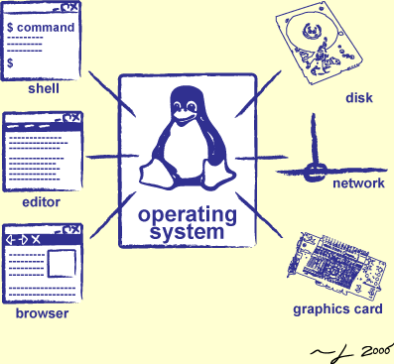
We will study..
Kernel Stack – another system data structure
System Calls
Application Programming Interfaces
A tree of processes in Linux

Slide 4
Read the following:
Book: Operating Systems: Principles and Practice (2nd Edition) Anderson and Dahlin
Volume 1, Kernel and Processes
Chapter 2.4: About Kernel Stack
Book: Operating Systems: Three Easy Pieces, by Remzi and Andrea Arpaci-Dusseau
Chapter 5: Process APIs

Slide 5
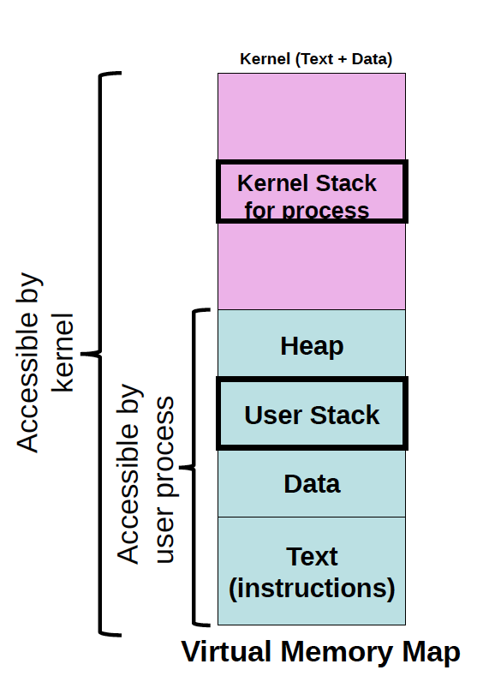
Kernel Stack
For each user level process, most OSs allocate two stacks for
User stack
Kernel stack
Kernel needs space to work
Can’t put anything on the user stack (?)

Slide 6
Kernel Stack
This simplifies switching to new process
When a process is running in user mode, the kernel stack is empty
The pointer to process’s kernel stack is stored in PCB
If the process is running on the processor on kernel mode, due to an interrupt or system call, it’s kernel stack contains
Registers (saved from the suspended process)
PC, Stack pointer
Flags (Processor status word in x86)
A special privileged hardware register (stack pointer) points to a region of kernel memory called the Kernel stack
Operating Systems Principles and Practice: Anderson and Dahlin

Slide 7
Kernel Stack
Operating Systems Principles and Practice: Anderson and Dahlin
Notes:
Lots of complexity on this slide. Let’s unpack:
Every process/thread has two stacks. When the process is running, does the kernel stack have anything useful on it? You might think yes – it called into the user program. But actually no – the user program doesn’t return from main.
When a process is ready to run, but not running – it has its user stack as before, but now I also need a place to store the state that had been in the CPU when it stopped running
When a process is waiting for I/O, it had done a system call, etc.

Slide 8
Kernel Stack contents
When the process is running, does the kernel stack have anything useful on it?
You might think yes – it called into the user program.
Actually no
When a process is ready to run, but not running
It has its user stack as before,
We need a place to store the state that had been in the CPU when it stopped running
When a process is waiting for I/O
The kernel stack contains the suspended computations
Eg Syscall handler state, I/O driver state etc
User CPU state: registers, PC, SP etc
Operating Systems Principles and Practice: Anderson and Dahlin

Slide 9
System Calls

Slide 10
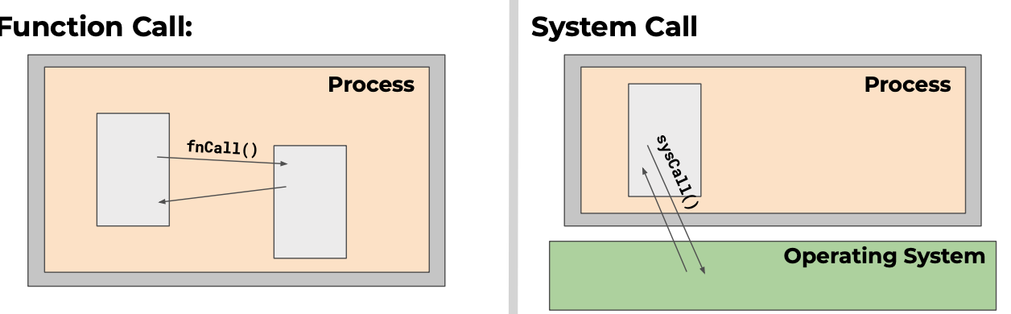
Function Calls vs System Calls
Caller and callee in the same process
Same user
Same “domain of trust”
OS is trusted; User process is not
OS code runs privileged with complete access to all system resources
CS 423 Operating System Design, Uinv of Illinois, Prof Fagen-Ullmschneider

Slide 11
System Calls (“Syscalls”)
Word Processing
Compilers
Web Browsers
Email
Databases
Web Servers
Application / Service
Portable OS Library
OS
User
System Call
Interface
System
Portable OS Kernel
Software
Platform support, Device Drivers
Hardware
x86
PowerPC
ARM
PCI
Ethernet (1Gbs/10Gbs)
802.11 a/g/n/ac
SCSI
Graphics
Thunderbolt
Crooks & Joseph CS162 © UCB Spring 2021

Slide 12
System Calls
API : Application Programming Interface
Function available to write user programs
System calls are the interface of the OS for
Processes
Creating, existing, waiting, and terminating
Memory
Allocation and deallocation
Files and Folders
Opening, reading, writing, closing
Inter Process Communication
We will study process system calls in later lectures

Slide 13
Should we rewrite programs for each OS?
POSIX API: a standard set of system calls that an OS must implement
Programs written to the POSIX API can run on any POSIX compliant OS
Most modern OSes are POSIX compliant – Ensures program portability
Program language libraries hide the details of invoking system calls
The printf function in the C library calls the write system call to write to screen
User programs usually do not need to worry about invoking system calls
C → libc → syscall

Slide 14
OS Library Issues Syscalls
Proc 1
Proc 2
Proc n
…
OS
Appln
login
Window Manager
…
libc
OS library
OS library
OS library
OS
Crooks & Joseph CS162 © UCB Spring 2021

Slide 15
APIs
Mostly accessed by programs via a high-level Application Programming Interface (API) rather than direct system call use

Slide 16
Multiple Sys Calls are needed ..
Consider following Unix command
cp in.txt out.txt
This command copies the input file in.txt to the output file out.txt
This seemingly simple command requires a large number of system calls
Write prompting message on terminal
To read keyboard input
To write text onto the terminal
Open input file and open output file
Copy text from input file to output file – in loop
Possible error message if files don’t exist
Closing both files on completion
And so on
Book: The Operating System Concepts: Silberschatz, Galvin, Gagne

Slide 17
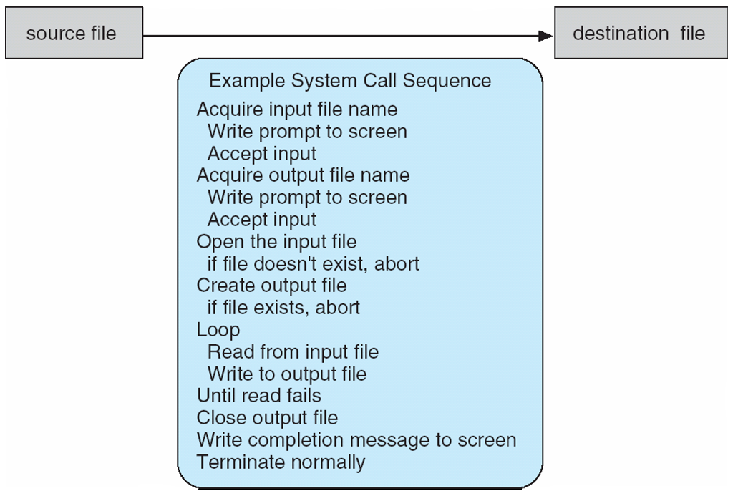
Example of System Calls
System call sequence to copy the contents of one file to another file
Book: The Operating System Concepts: Silberschatz, Galvin, Gagne

Slide 18
Application APIs

Slide 19
Application Programming Interface (API)
A simple program uses hundreds of system calls in a short time
Application Programmers use APIs
API specifies
a set of functions that are available to an application programmer
Parameters passed to each function and return values it can expect
Three most common APIs are Win32 API for Windows, POSIX API for POSIX-based systems (including virtually all versions of UNIX, Linux, and Mac OS X), and Java API for the Java virtual machine (JVM)
A programmer accesses an API via a library of code provided by the operating system
libc: For Linux and Unix, library for programs written in C

Slide 20
APIs vs System Call
System Call is an explicit request to the kernel made via a software interrupt
API is a function definition that specifies how to obtain a given service
An OS has several libraries of functions that provide APIs to programmers:
Some APIs provide services to users in User Mode
Other APIs use system calls (in turn use kernel mode)
Wrapper over system call with added functionality
Example:
In Linux, the malloc( ) , calloc( ) , and free( ) APIs are implemented in the libc library
The code in this library keeps track of the allocation and deallocation requests and uses the brk( ) system call to enlarge or shrink the process heap

Slide 21
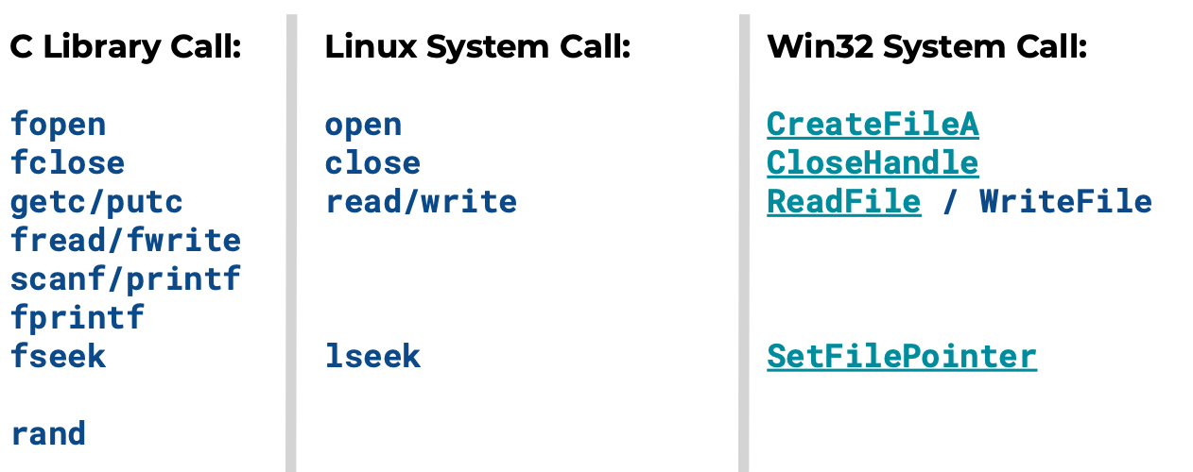
Examples of API calls and System Calls
CS 423 Operating System Design, Uinv of Illinois, Prof Fagen-Ullmschneider

Slide 22
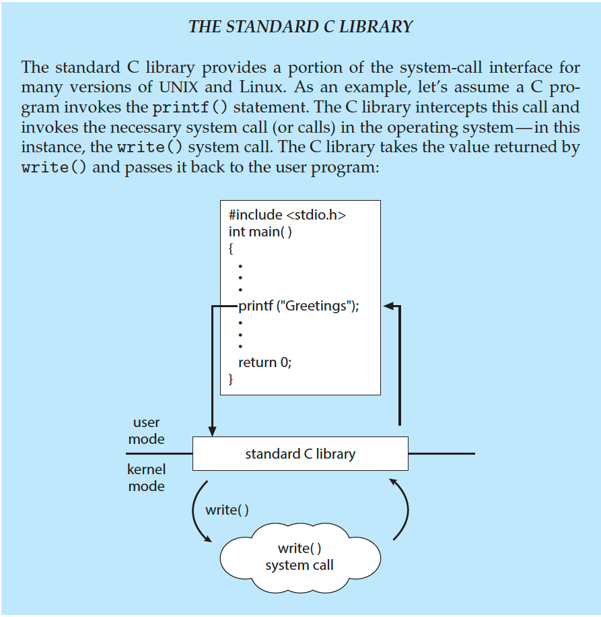
Standard C Library Example
C program invoking printf() library call, which calls write() system call
Book: The Operating System Concepts: Silberschatz, Galvin, Gagne

Slide 23
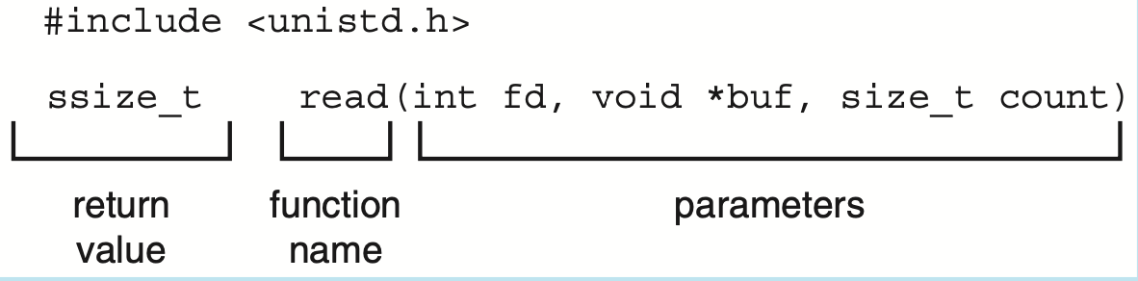
Advantages of using APIs instead of System Calls
Program Portability
Application programmer need not worry about processor and OS?
Simple to use compared to system calls
Standard read API is described as
int fd—the file descriptor to be read
void *buf—a buffer into which the data will be read
Size_t count—the maximum number of bytes to be read into the buffer

Slide 24
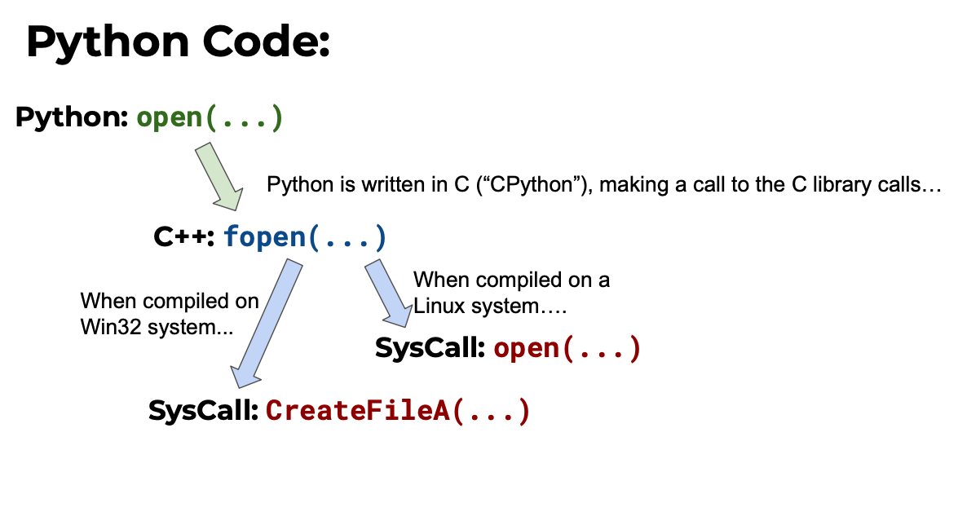
Python Code
CS 423 Operating System Design, Uinv of Illinois, Prof Fagen-Ullmschneider

Slide 25
System Call Implementation

Slide 26
System Call Implementation
Typically, a number is associated with each system call
System-call interface maintains a table indexed according to these numbers
The system call interface invokes the intended system call in OS kernel and returns status of the system call and any return values
The caller need know nothing about how the system call is implemented
Just needs to obey API and understand what OS will do as a result call
Most details of OS interface hidden from programmer by API
Managed by run-time support library (set of functions built into libraries included with compiler)

Slide 27
System Call Implementation
When a process makes a system call, the processor switches to kernel mode
In Kernel mode it runs System Call handler
User process passes a parameter called system call number and other parameters
System call handler is similar to other exception handler (will study it later). It performs the following actions:
Saves contents of registers in Kernel Mode Stack
Handles the system call by invoking a function called system call service routine
Exit from handler: Regs are loaded with values saved in Kernel stack ; CPU is switched back to user mode

Slide 28
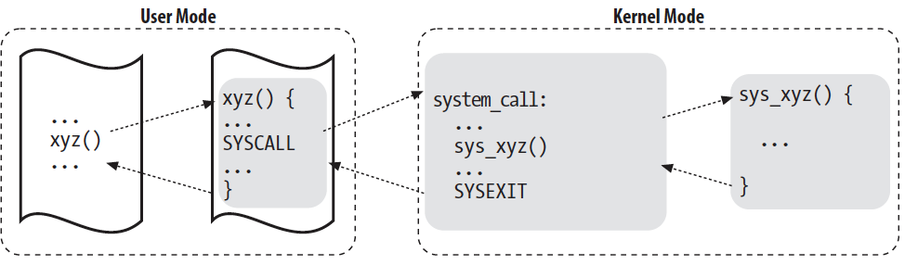
Invoking a system call from Applications
Application
program
Wrapper
Routine
System Call
handler
System Call
Service Routine
Book Understanding the Linux Kernel, by Bovet and Cesati

Slide 29
Types of System Calls

Slide 30
Types of System Calls
Process control
File Management
Device Management
Information Management
Communications
Protection

Slide 31
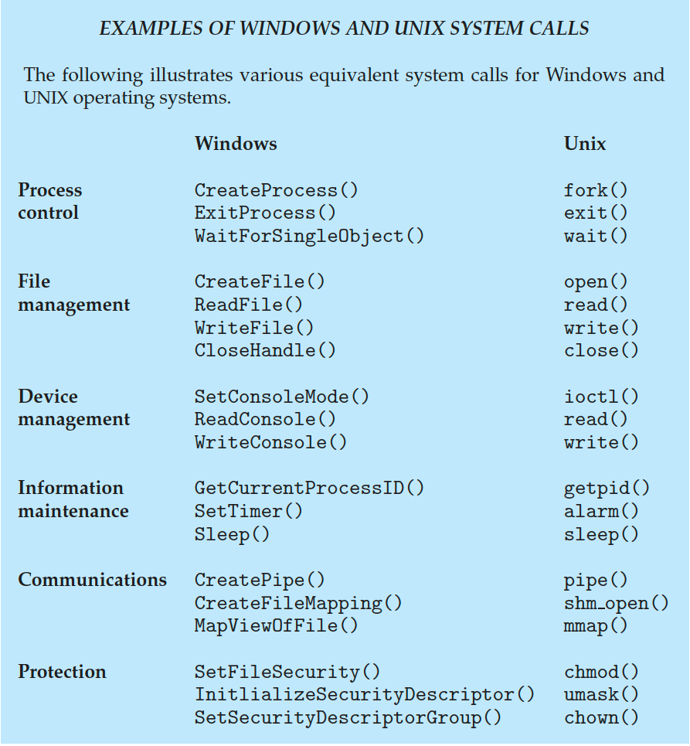
System Calls in Windows and Unix
Book: The Operating System Concepts: Silberschatz, Galvin, Gagne

Slide 32
Process Control - System Calls
create process, terminate process
end, abort
load, execute
get process attributes, set process attributes
wait for time
wait event, signal event
allocate and free memory
Dump memory if error
Debugger for determining bugs, single step execution
Locks for managing access to shared data between processes – acquire_lock() and release_lock()
Book: The Operating System Concepts: Silberschatz, Galvin, Gagne

Slide 33
File and Device Management - System Calls
File management
create file, delete file
open, close file
read, write, reposition
get and set file attributes
Device management
request device, release device
read, write, reposition
get device attributes, set device attributes
logically attach or detach devices
Book: The Operating System Concepts: Silberschatz, Galvin, Gagne

Slide 34
Information and Communication - System Calls
Information maintenance
get time or date, set time or date
get system data, set system data
get and set process, file, or device attributes
Communications
create, delete communication connection
message passing model - send, receive messages to host name or process name
From client to server
Shared-memory model create and gain access to memory regions
Book: The Operating System Concepts: Silberschatz, Galvin, Gagne

Slide 35
Protection - System Calls
Protection
Control access to resources
Get and set permissions
Allow and deny user access
Book: The Operating System Concepts: Silberschatz, Galvin, Gagne

Slide 36
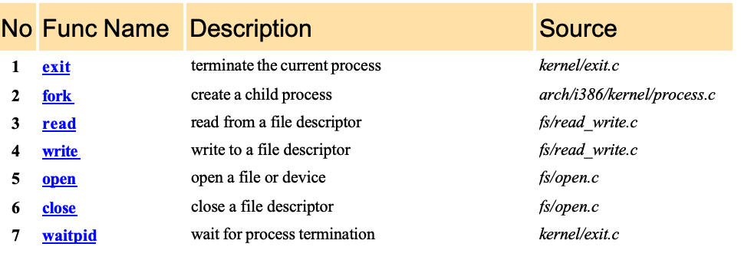
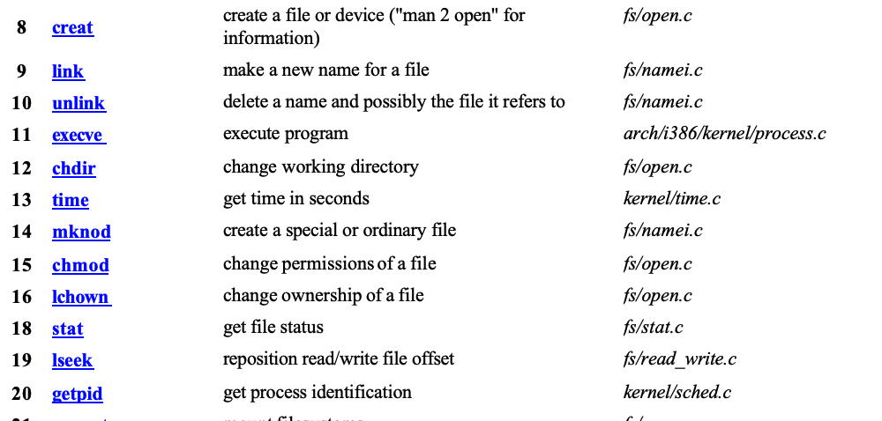
Linux System Call
http://www.cheat-sheets.org/saved-copy/Linux_Syscall_quickref.pdf
Linux Kernel 3.7 has 393 system calls

Slide 37
Process Creation

Slide 38
Process Creation
During execution, a process may create several new processes
Creating Process: Parent Process
New Processes: Children Processes
Each of the children process may create other processes
Forming Tree of processes
The systemd process (which always has a pid of 1) serves as the root parent process for all user processes
Systemd process in Unix is called init process
Book: The Operating System Concepts: Silberschatz, Galvin, Gagne

Slide 39
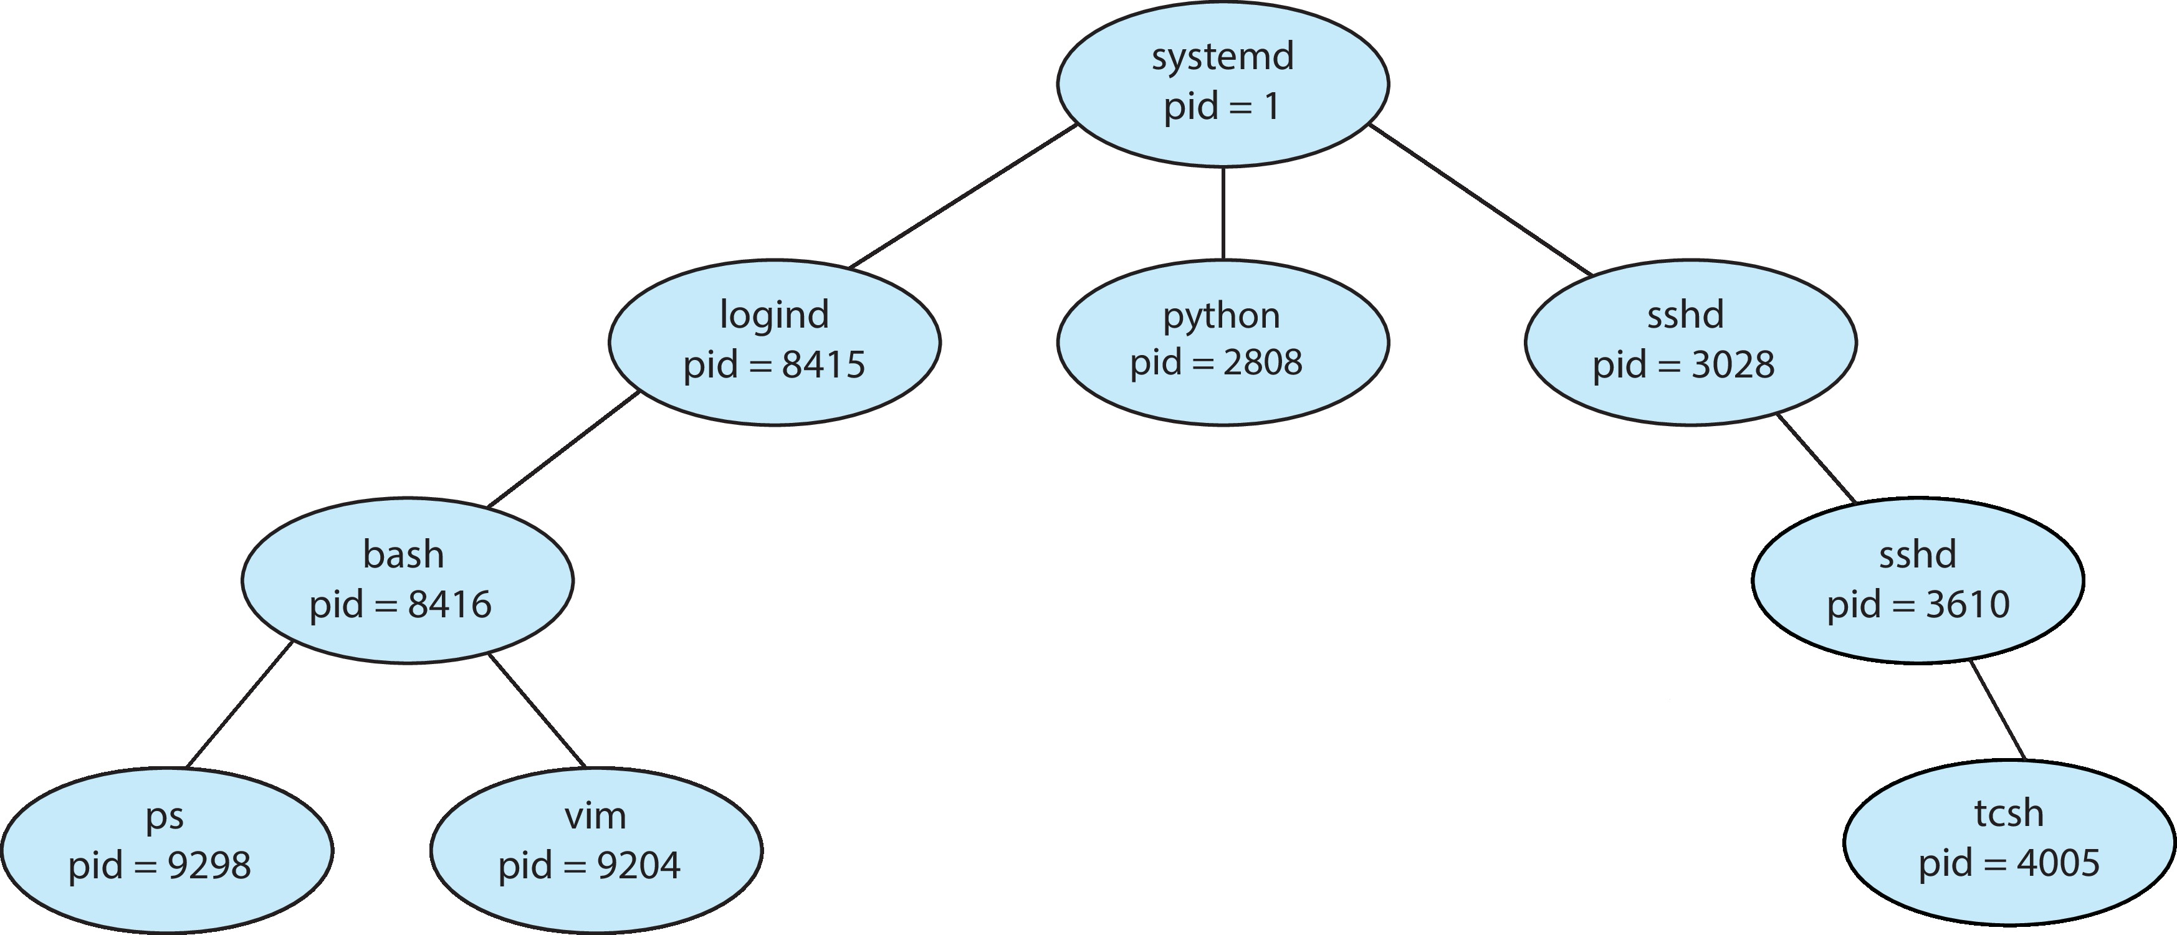
A Tree of Processes in Linux
Secure Shell
ps -el command gives details of all active processes in the system
Book: The Operating System Concepts: Silberschatz, Galvin, Gagne

Slide 40
Class Summary
System Calls
System calls are interface for OS for manipulation of
Processes
Memory
File and folders
Application APIs
A programmer usually uses higher level APIs instead of system calls
User Interfaces: GUI, Command line, Touch Screen
A tree of processes

Slide 41
User Interfaces (For self reading)

Slide 42
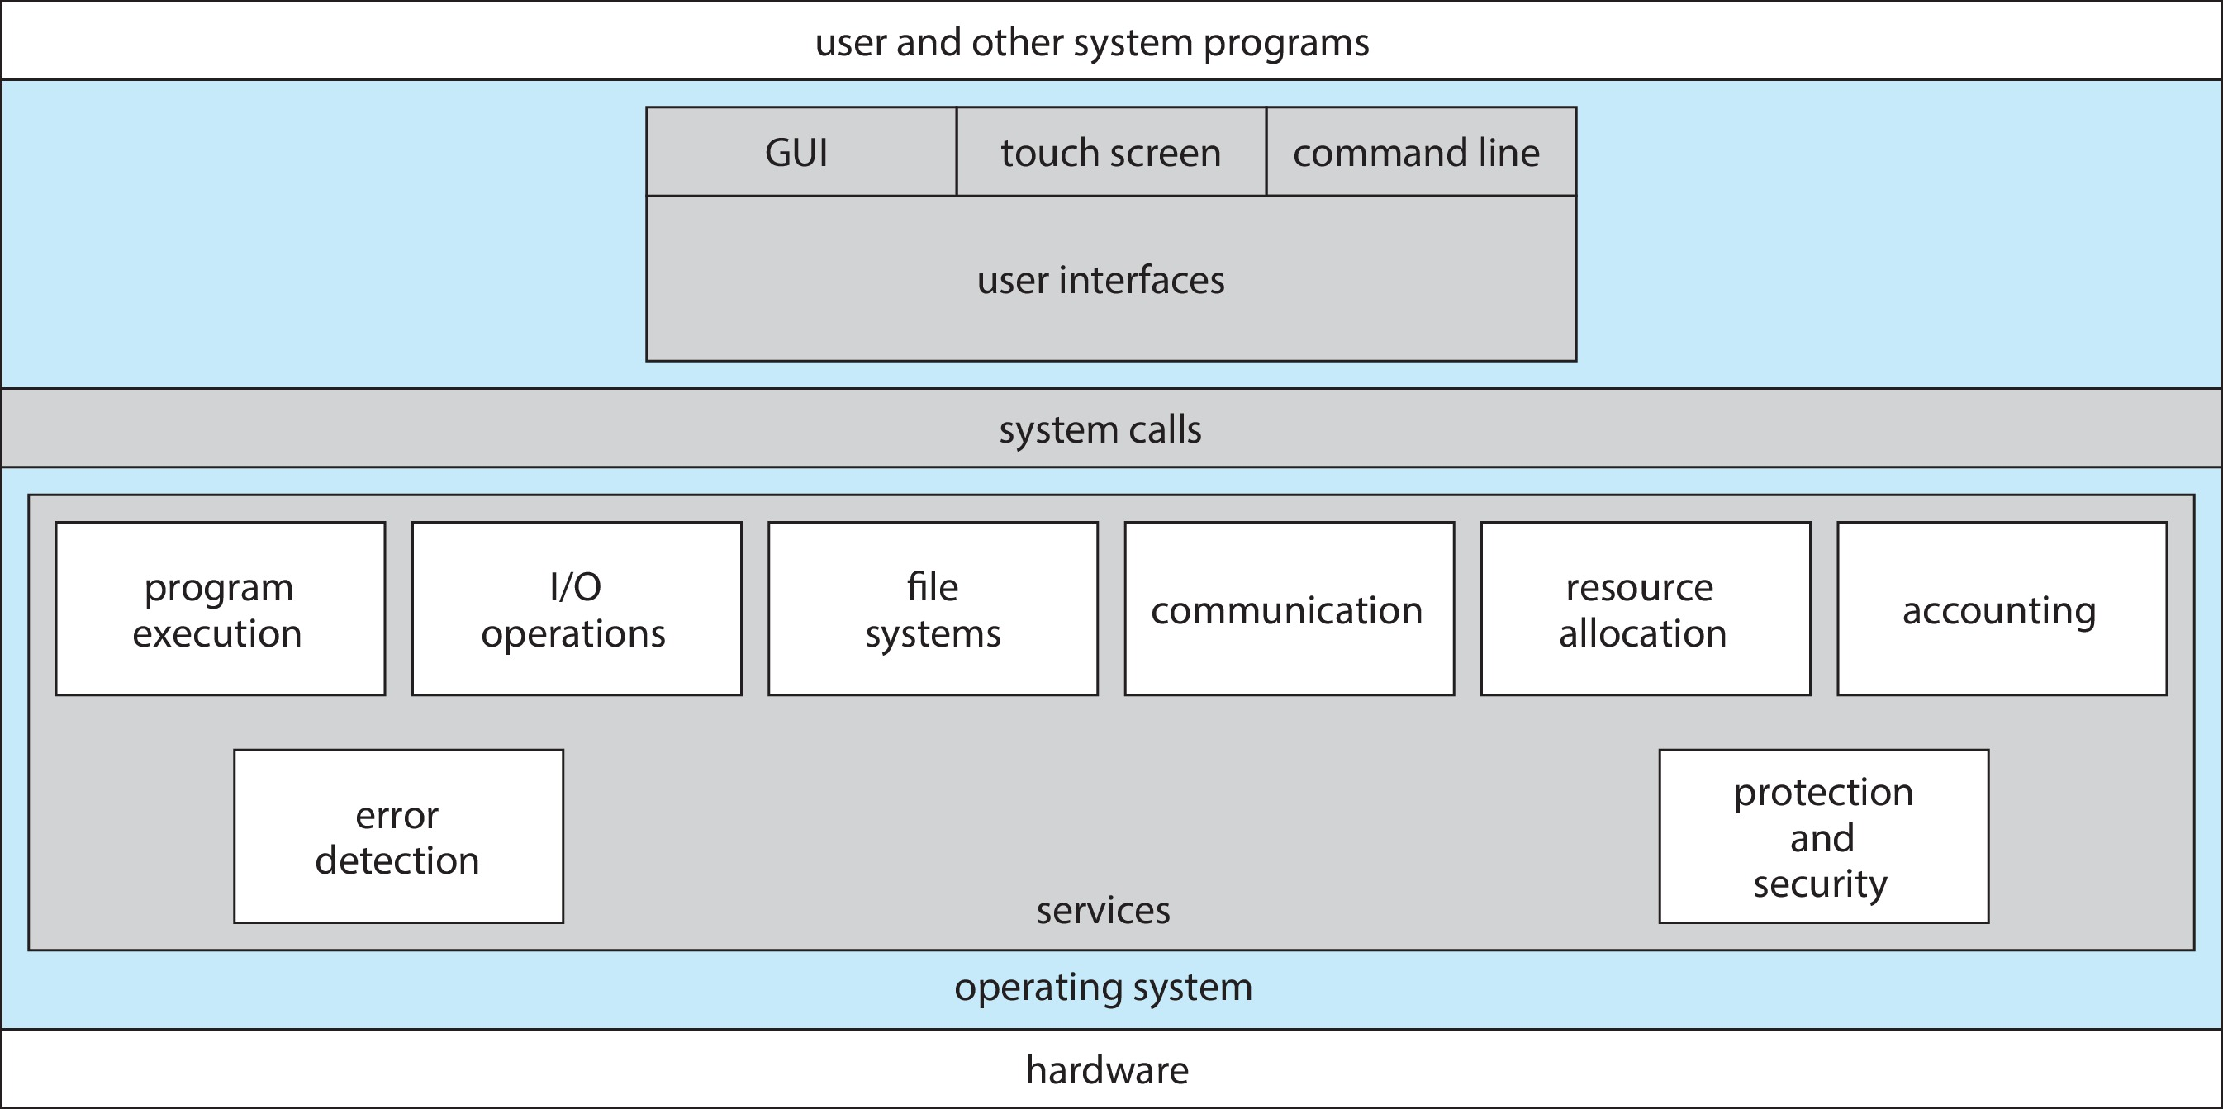
User Interfaces
OS Book: Silberschatz, Galvin and Gagne ©2018

Slide 43
User Interfaces
GUI
Touch Screen
Command Line Interface (CLI)
Uses text command
Allows users to directly enter commands executed by the OS
Shells: Command Line Interpreters
C-Shell
Bourne-Again Shell (bash)
Korn Shell
Example: Shell commands to
Create, delete, list, print, copy, execute - files
OS Book: Silberschatz, Galvin and Gagne ©2018

Slide 44
Interfaces
GUIs are convenient for common users
Not all functionalities are available with GUIs
CLIs : More powerful .. Used by advanced users and system administrators
More efficient, faster access, makes repetitive tasks easier
If a frequent task requires a set of command- line steps, those steps can be recorded into a file, and that file can be run just like a program
This program is interpreted by CLI
Shell Scripts
Windows OS provides GUI
MacOS provides both GUI and CLI

Slide 45
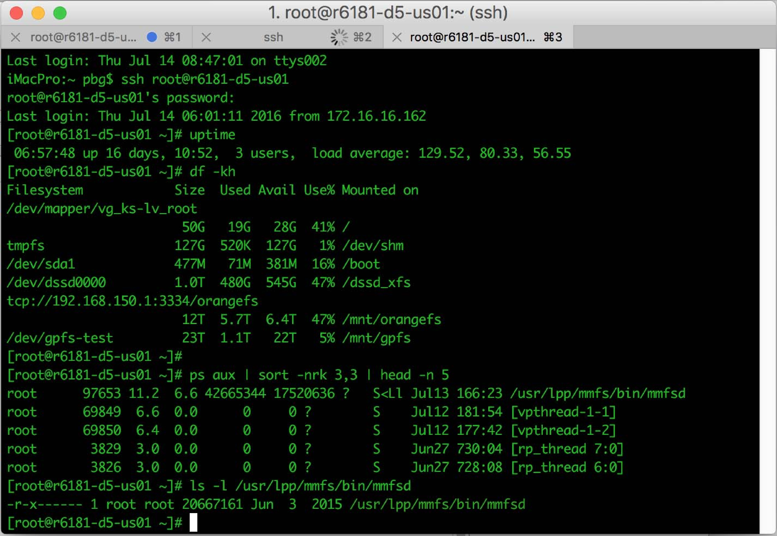
Bourne Shell Command Interpreter
OS Book: Silberschatz, Galvin and Gagne ©2018

Slide 46
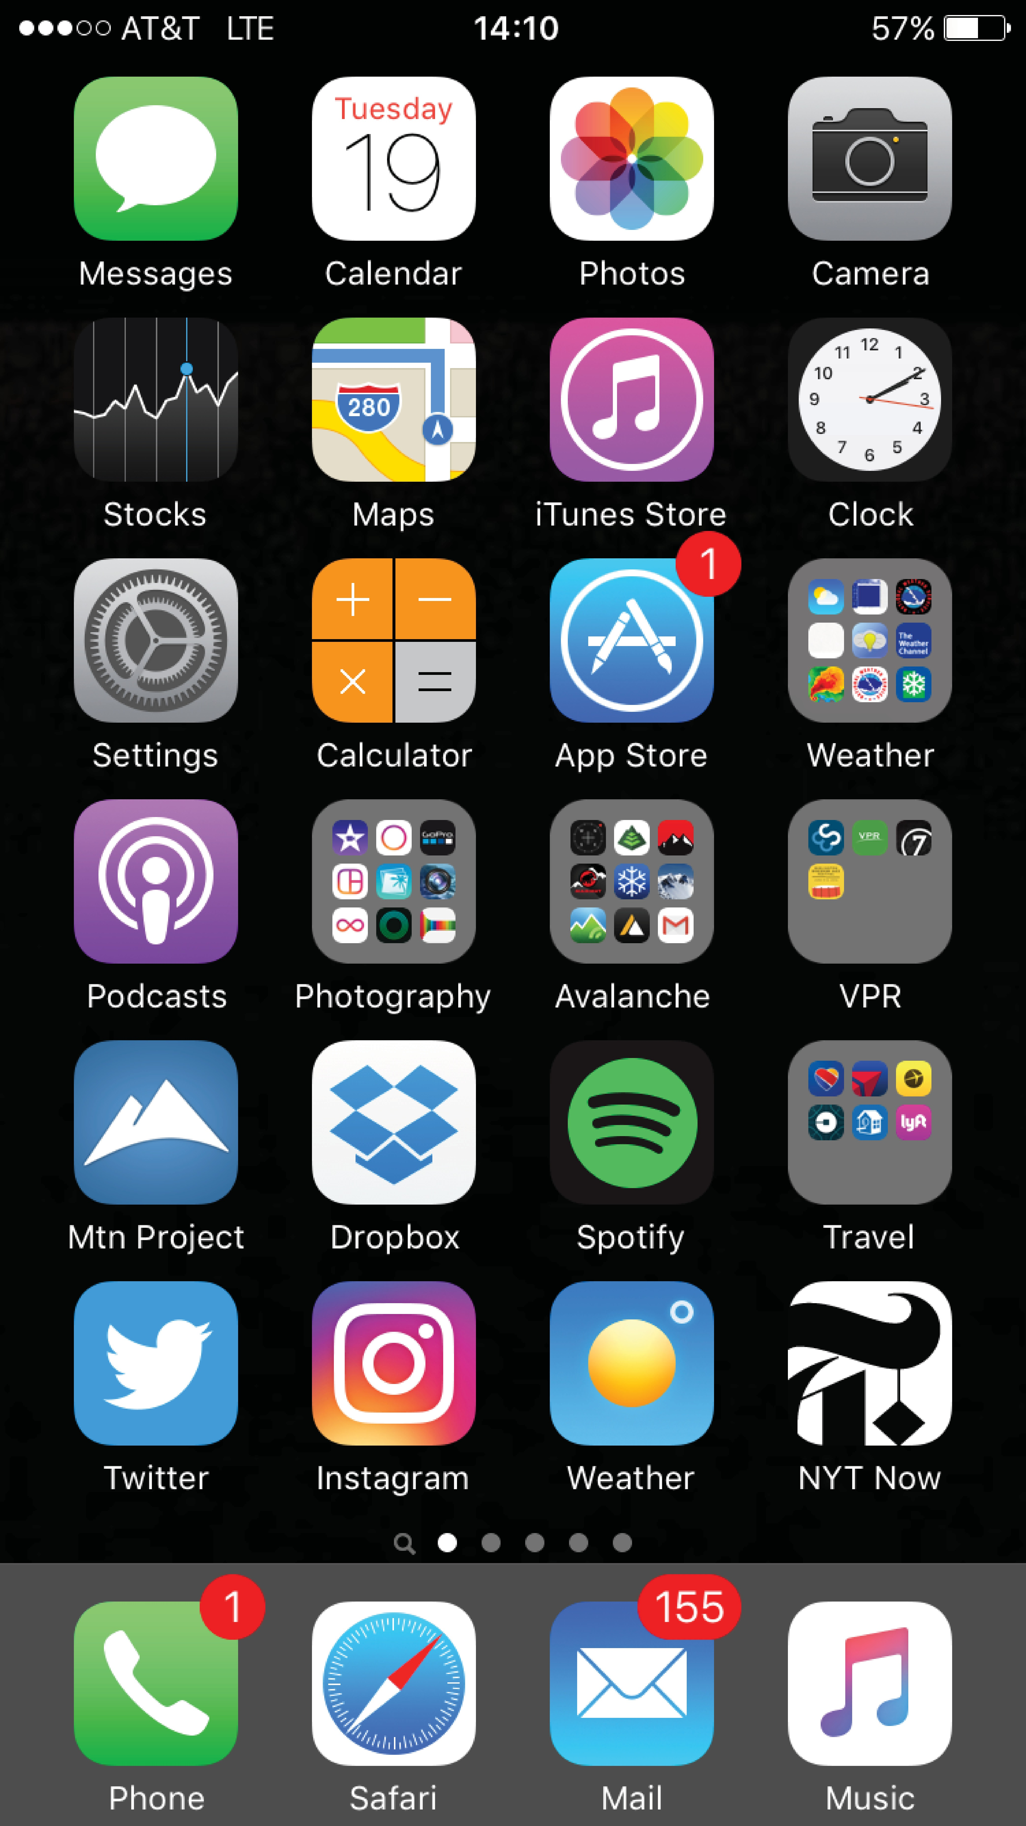
Touchscreen Interfaces
Touchscreen devices require new interfaces
Mouse not possible or not desired
Actions and selection based on gestures
Virtual keyboard for text entry
Voice commands
OS Book: Silberschatz, Galvin and Gagne ©2018

Slide 47
System Calls - types

